Slide 1


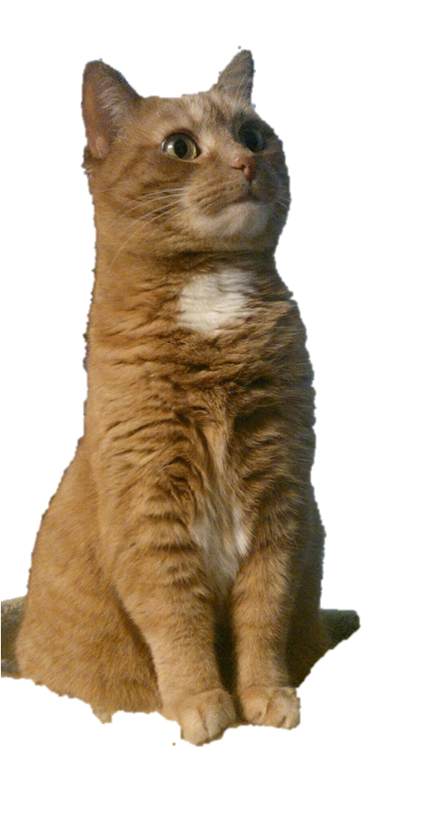
In the forest surrounding Fairsway, a little girl studies without rest under a famous potions maker. Nothing seems to go right for Faye, though. She messes up even as she tries her hardest. When her cat disappears one day, she panics just thinking about what her master will say.
But, no, Faye’s determined to not be scolded this time. She’ll be “responsible” and protect her cat by herself. She decides to chase after him. On her quest, Faye will have to use every bit of knowledge she has gained over her apprenticeship. All that studying couldn’t have been for nothing.
Cat

